Slide 1
Tunnelling Association of Canada
Equity, Diversity, and Inclusion Moment
Humility and Respect

Slide 2
Tunnelling Association of Canada
What are humility and respect?
Humility: having a modest view of one’s own importance, humbleness
Respect: having due regard for the feelings, wishes, rights, or traditions of others
2

Slide 3
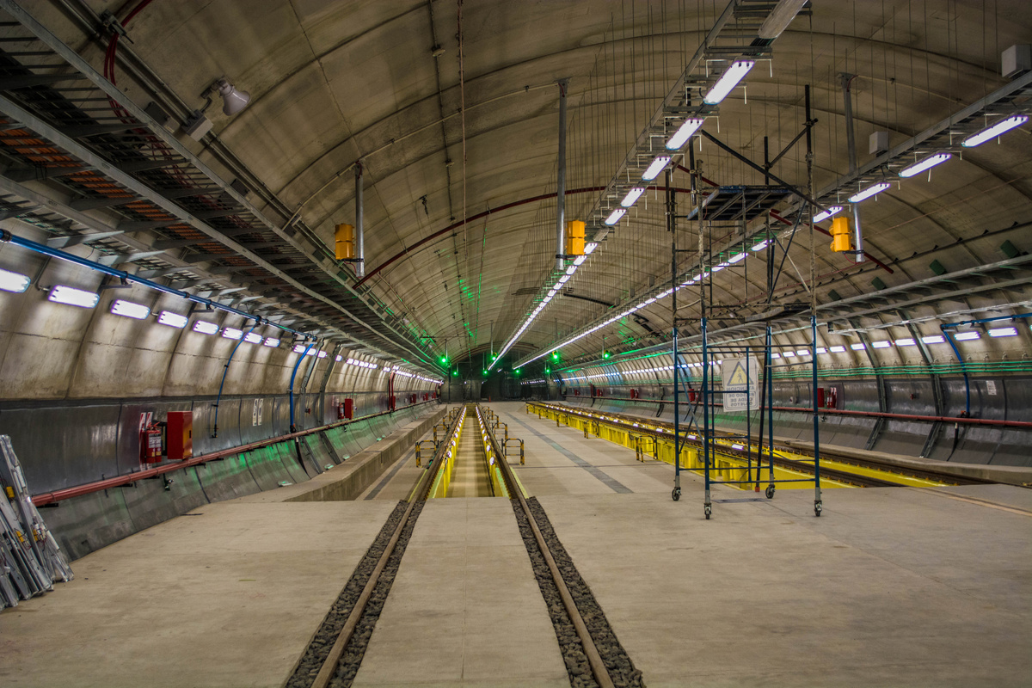
Tunnelling Association of Canada
Humility and respect in the workplace
Showing humility and respect for the cultural differences of those you work with increases feelings of belonging
5

Slide 4
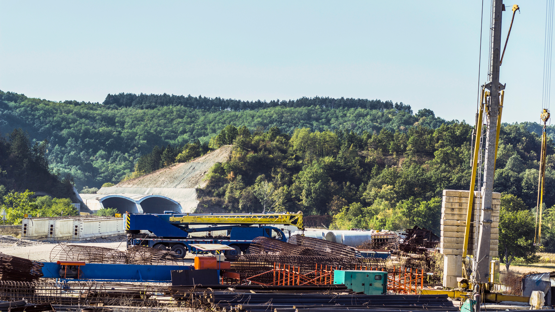
Tunnelling Association of Canada
How to foster a culture of humility and respect
Be curious and humble about learning cultural differences; no one is an expert!
Respect and embrace other people's experiences and realities.
Be open - don't get defensive throughout the process.
3

Slide 5
Tunnelling Association of Canada
Date
Thank you!
The End

